Slide 1
Online GPS II/MAPP
Meetings 1 – 10

Slide 2
Meeting 7 Gains and Losses: Helping Children Leave Foster Care

Slide 3
License Rights to OCFS
Center for Development of Human Services, Institute for Community Health Promotion, SUNY Buffalo State acknowledges the State of New York’s and the Office of Children and Family Services’ royalty-free, non-exclusive and revocable license to reproduce, publish, distribute, or otherwise use any and all material herein for the limited purpose of training GPSII/MAPP Leaders and for as long as such materials and such training are deemed appropriate by NYS OCFS.
The Children’s Alliance of Kansas (CAOK) is the current national owner of the copyrighted “toolbox” of MAPP programs. NYS Office of Children and Family Services (NYS OCFS)/Center for Development of Human Services (CDHS) has permission from CAOK to provide MAPP programs (GPSII/MAPP, Caring For Our Own, Deciding Together, Shared Parenting, Mini-MAPP, and Child Sexual Abuse) to certify leaders through leader certification workshops and directly to foster/adoptive parents in New York State.
In order to better meet the needs of children and families in New York State, PS-MAPP was revised in 2004 and renamed GPSII/MAPP. Further revisions were made in 2005 after considering the feedback from MAPP Leaders throughout the state, and minor revisions and reformatting occurred in 2009. Significant revisions to the content and updating to reflect best practice and legal changes in New York State were made and approved by NYS OCFS in 2012 for this edition.
© 2009 Children’s Alliance of Kansas. Revised with permission NYS OCFS.

Slide 4
Rules of the Road
Place Holder…

Slide 5
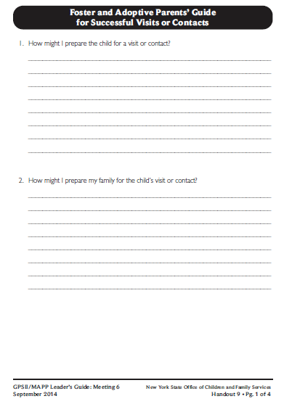
Roadwork from Last Meeting:
Meeting 6 Handout 9, Foster and Adoptive Parents’ Guide for Successful Visits or Contacts
Comments
or
Questions?

Slide 6
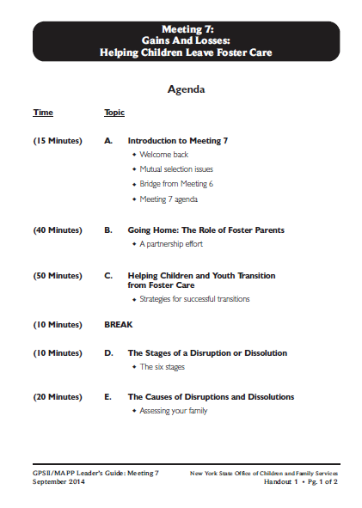

Slide 7
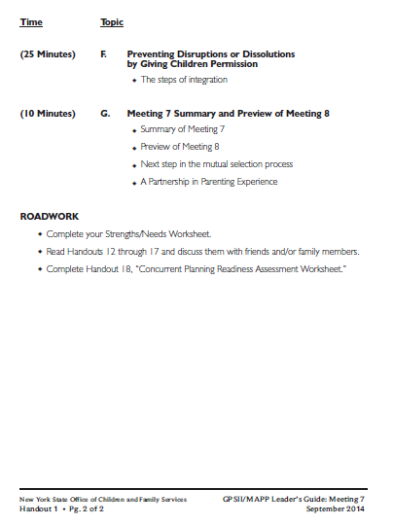

Slide 8
What’s the Difference?
Meeting 3
Losses and Gains:
The Need to Be a Loss Expert
Meeting 7
Gains and Losses:
Helping Children Leave Foster Care

Slide 9
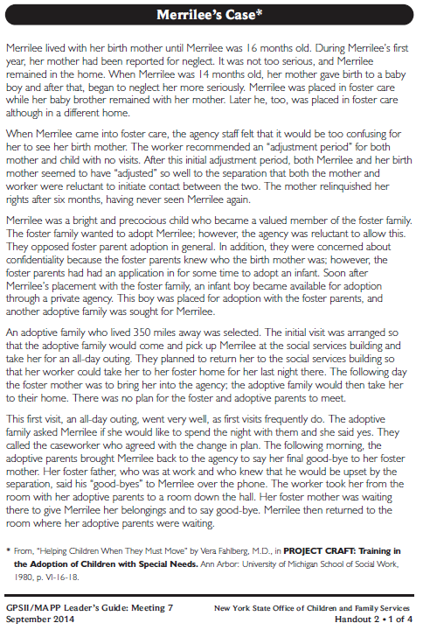
Let’s look at: Handout 2, Merrilee’s Case

Slide 10
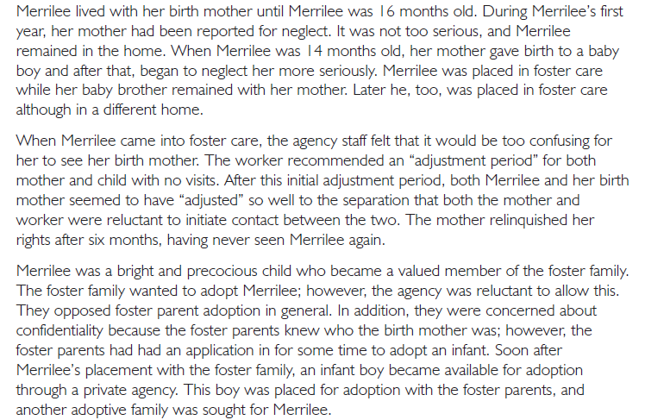

Slide 11
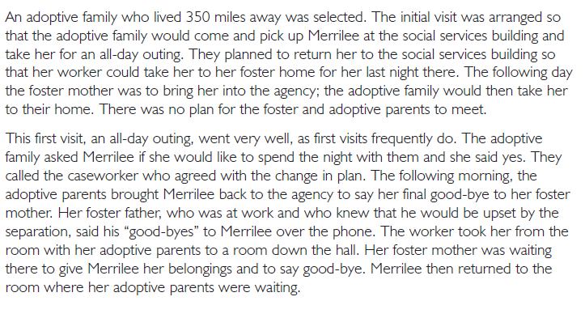

Slide 12
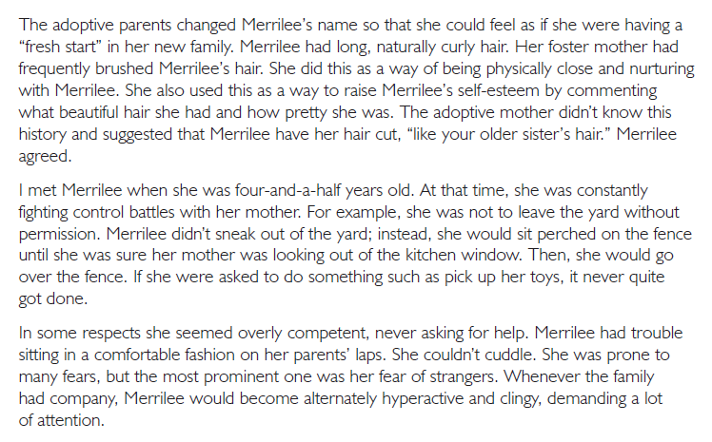

Slide 13
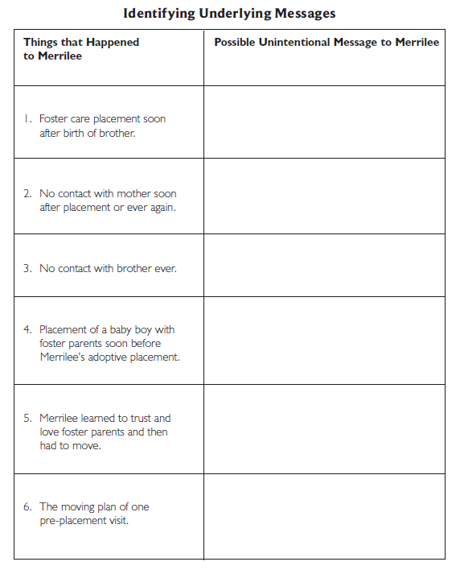

Slide 14
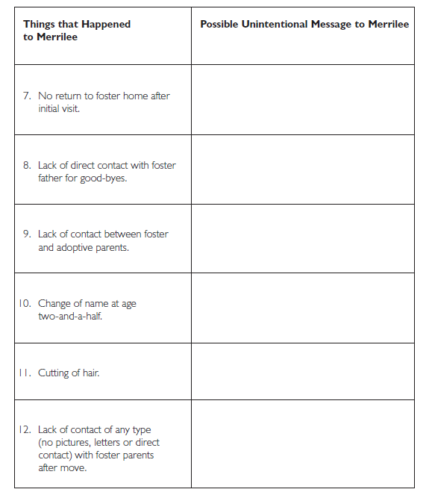

Slide 15
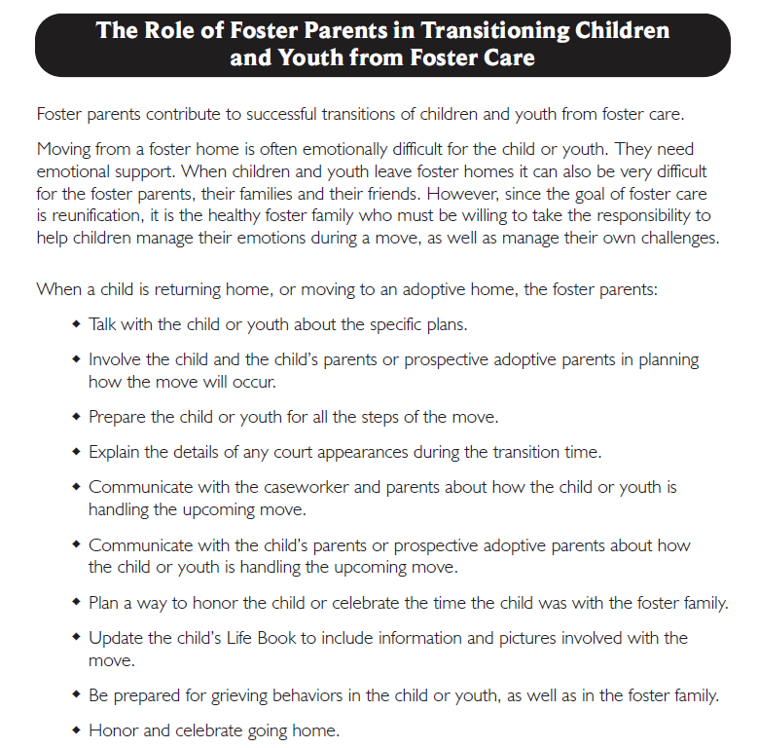
Let’s look at:
Handout 3

Slide 16
Video: Angela
Placeholder

Slide 17
Questions for Angela Video
What did Angela’s foster mother do or say that made it possible for Angela to trust her?
What went right for Angela?
What are the risks for children and youth in foster care when unplanned moves occur?

Slide 18
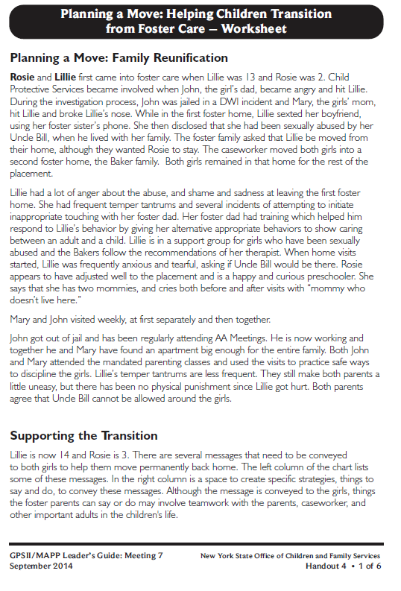
Let’s look at:
Handout 4
(Page 1)

Slide 19
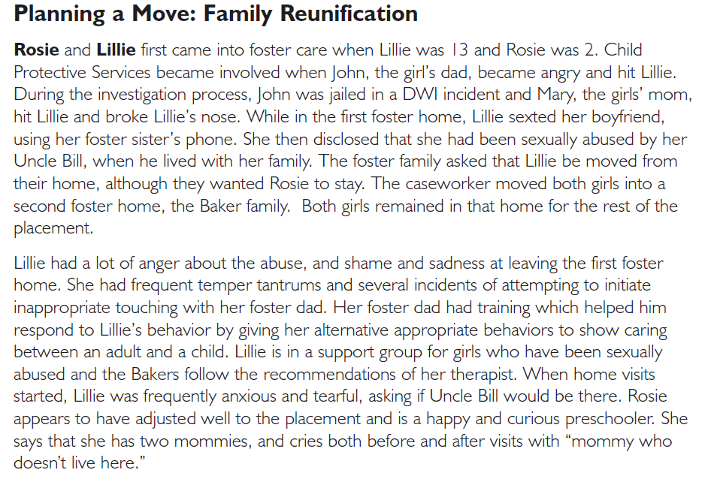

Slide 20
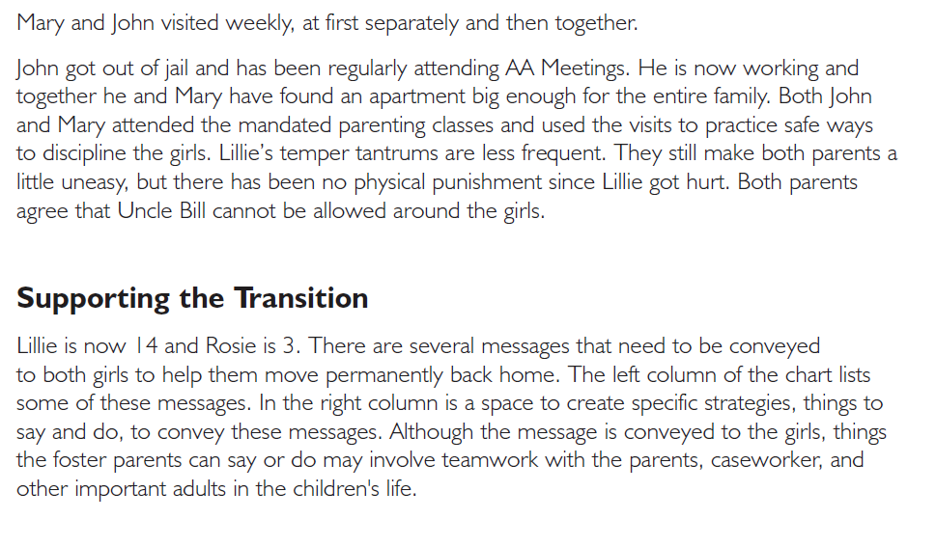

Slide 21
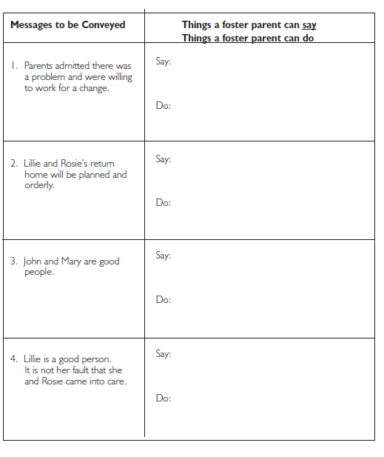

Slide 22
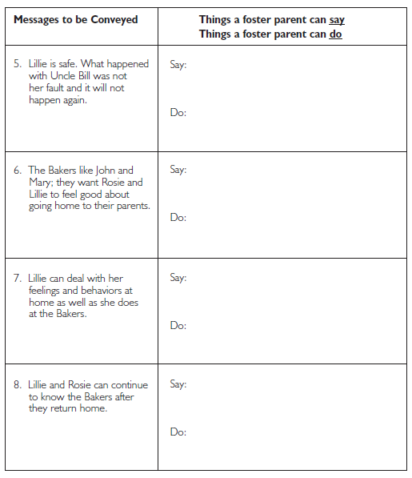

Slide 23
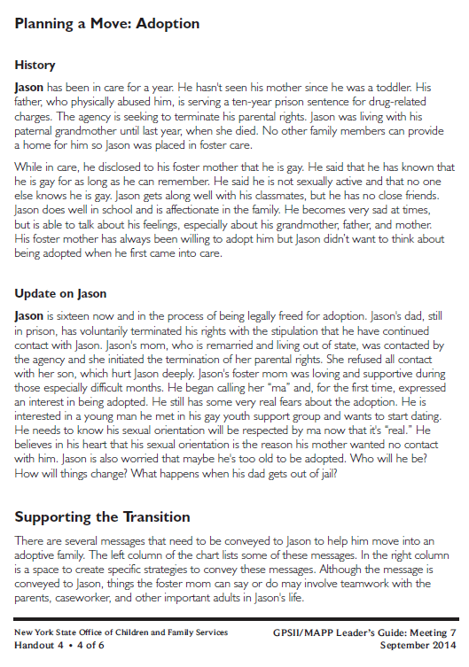
Let’s look at:
Handout 4
(Page 4)

Slide 24
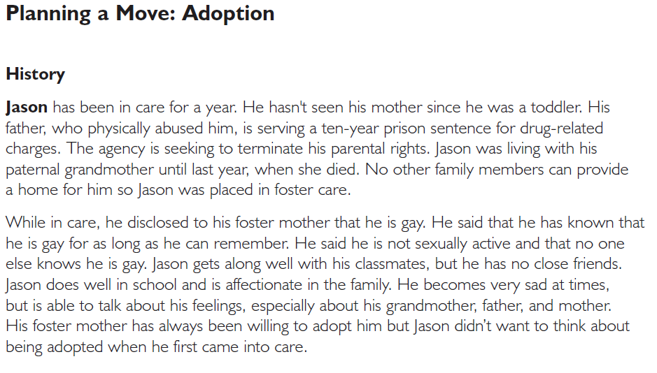

Slide 25
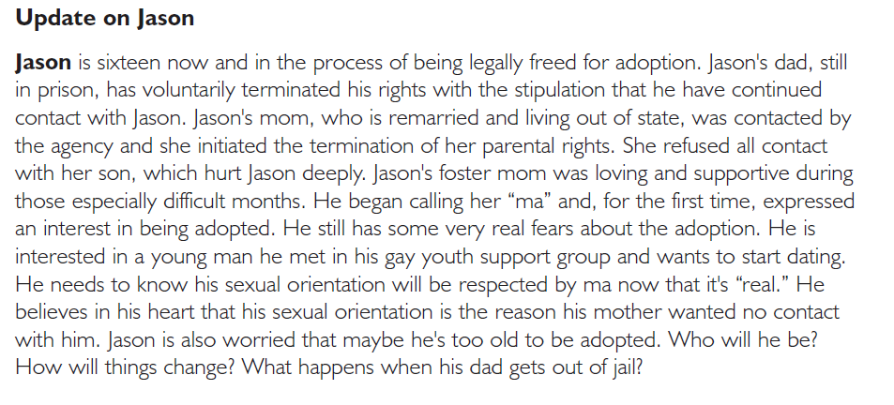

Slide 27
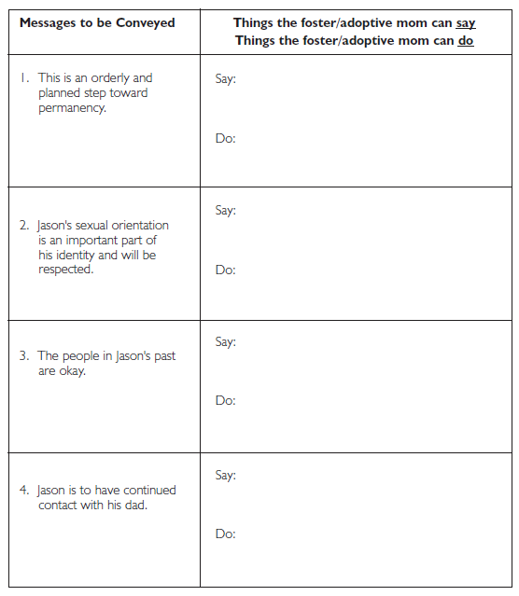

Slide 28
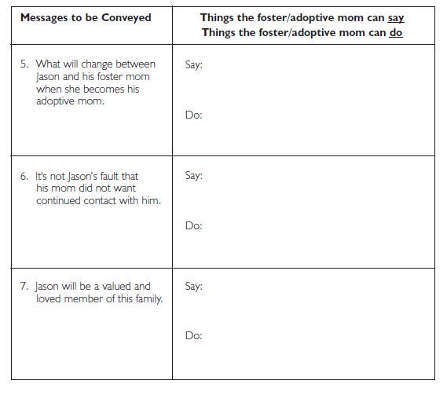

Slide 29
What are important messages to a child about moving from one foster home to another?

Slide 30
What messages should be conveyed to a youth who is leaving foster care to live as a self-sufficient adult?

Slide 31
Respite Care
A service that agencies provide to foster families when they need to have a break from the responsibility of being caregivers.

Slide 32
Respite Care
Possible Benefits:
Possible Problems or Challenges:

Slide 33
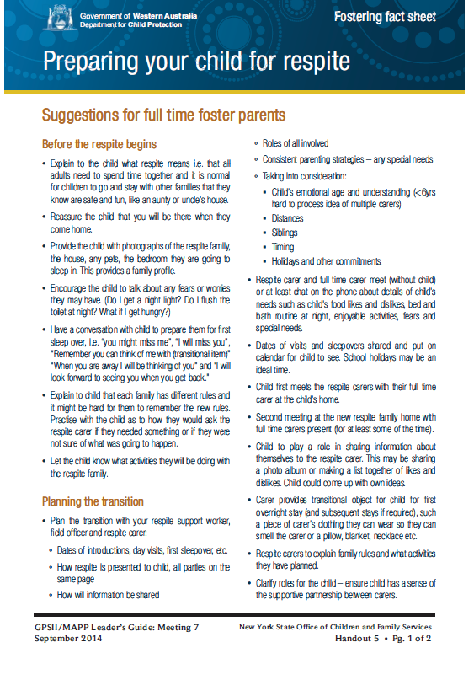
Roadwork Reading: Handout 5

Slide 34
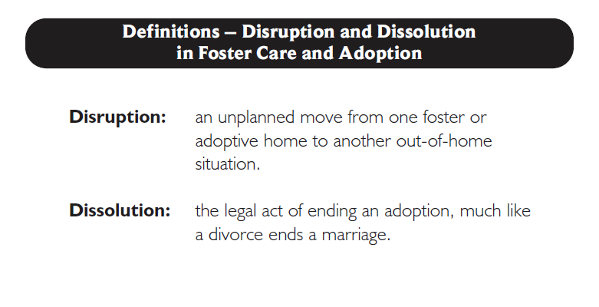
Let’s look at: Handout 6

Slide 35
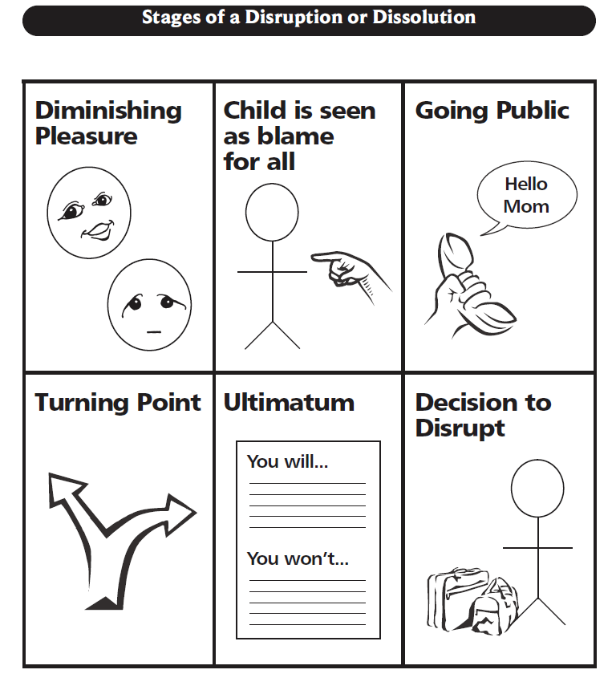
Let’s look at:
Handout 7

Slide 36
Causes of Disruption

Slide 37
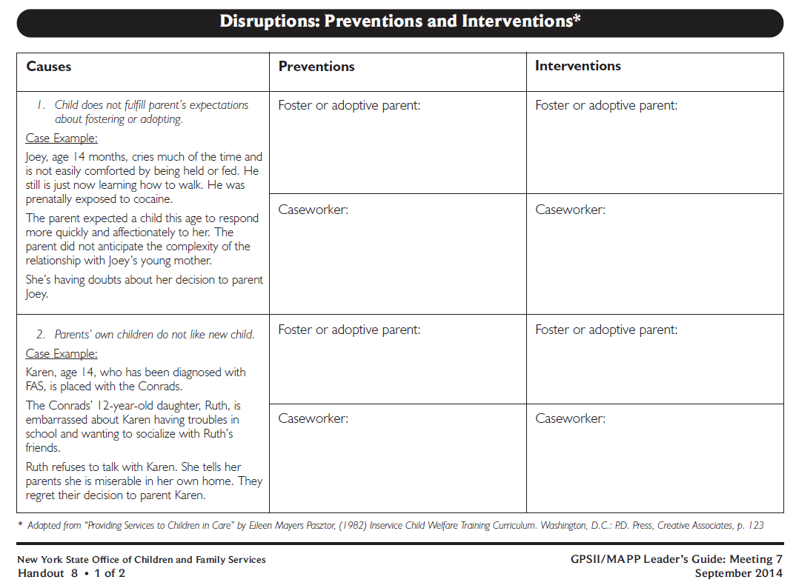
Let’s look at: Handout 8, Disruptions: Preventions and Interventions

Slide 38
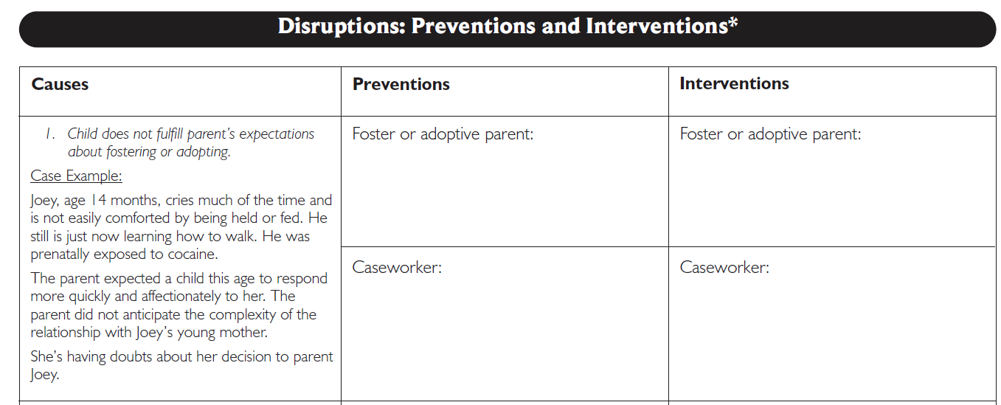

Slide 40
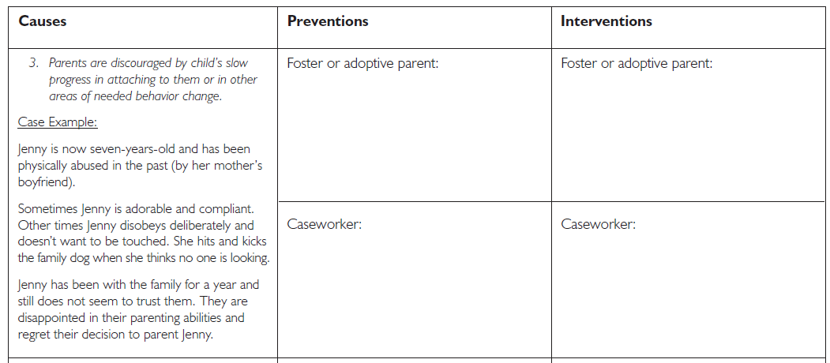

Slide 41
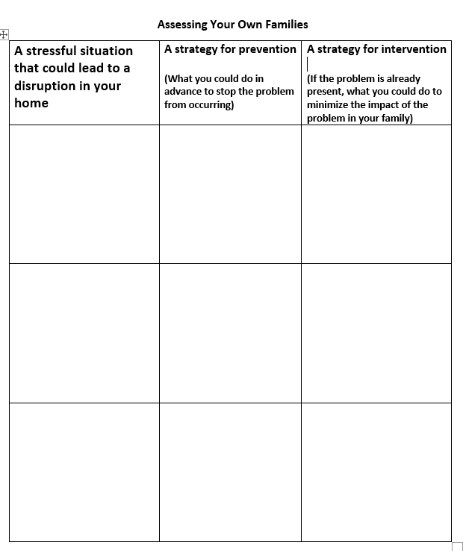
Let’s look at: Supplemental Handout 1

Slide 42
Twelve Skills for Successful Fostering and Adopting
Know your family
Communicate Effectively
Know the children
Build strengths, meet needs
Work in partnership
Be loss and attachment experts
Manage behaviors
Build connections
Build self-esteem
10. Assure health and safety
Assess impact
Make an informed decision

Slide 43
Integration
Giving children permission to live with and love another family
Integrate means “to make whole by bringing the parts together”

Slide 44
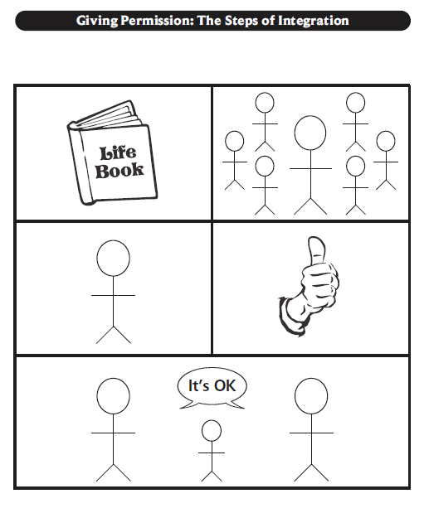
Let’s look at:
Handout 9

Slide 45
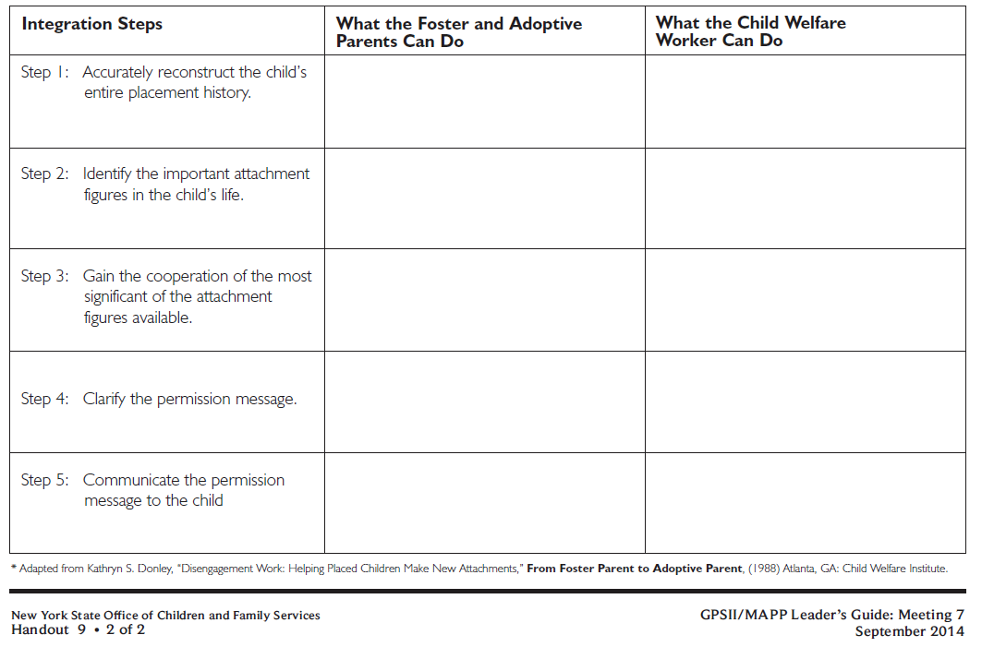

Slide 46
Commemoration
An activity to honor important people in the child’s life
A way of helping a child express grief
Another way for important adults to demonstrate support and permission to love the people who are part of the child’s past, present, and future

Slide 47
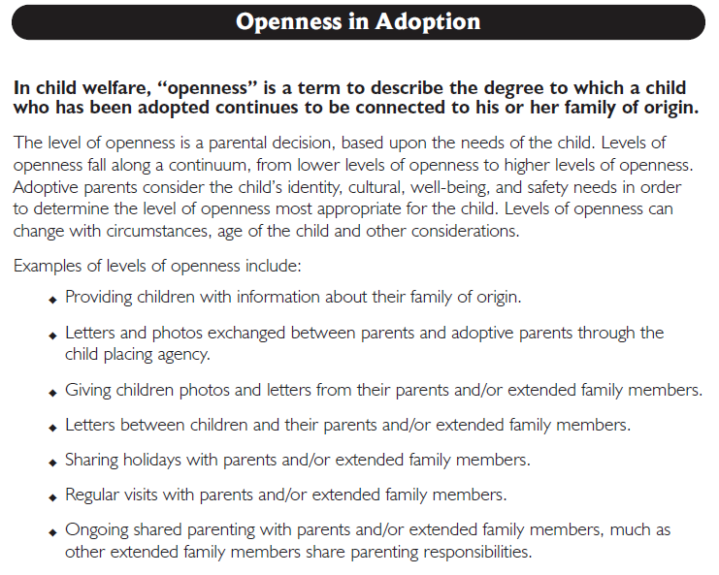
Let’s look at: Handout 10

Slide 48
Openness in Adoption
“Openness” describes the degree to which a child, who has been adopted, is connected to his or her birth family.
Level of openness is a parental decision, based upon the child’s needs.
Levels of openness fall along a continuum.
- +

Slide 49
Gains from Foster Care
Losses from Foster Care

Slide 50
Roadwork
Complete Handout 11, Strengths/Needs Worksheet
Read Handouts 12 through 17 and discuss them with friends and/or family members
Complete Handout 18, Concurrent Planning Readiness Assessment Worksheet

Slide 51
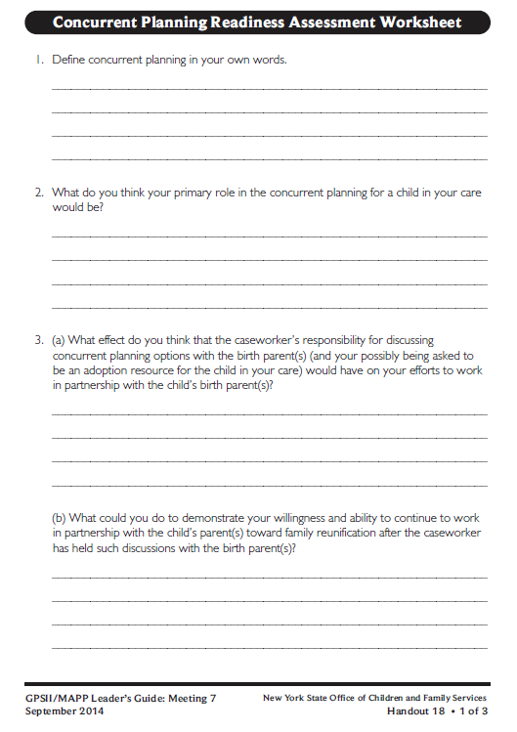
Roadwork: Complete Handout 18, Concurrent Planning Readiness Assessment Worksheet

Slide 52
It’s Time for a PIP!
Partnership
In
Parenting Experience

